Slide 1
Highly-Scalable Searchable Symmetric Encryption With Support For Boolean Queries
David Cash/Stanislaw Jarecki/Charanjit Jutla/Hugo Krawczyk
Advances in Cryptology – CRYPTO 2013
汇报人：魏佩

Slide 2



































Boolean Queries
Boolean Queries
$$w_{1}$$
$${id}_{1}$$
$${id}_{3}$$
$w_{1}∧$ $w_{2}$ $∧$ $w_{3}$
$$w_{2}$$
$${id}_{2}$$
$${id}_{4}$$
$${id}_{3}$$
$${id}_{1}$$
$${id}_{3}$$
$$w_{3}$$
$${id}_{2}$$
$${id}_{3}$$
$${id}_{4}$$
$${id}_{1}$$
$${id}_{2}$$
$${id}_{3}$$
$${id}_{4}$$
$$w_{1}$$
$${id}_{1}$$
$${id}_{3}$$
$$w_{1}$$
$$w_{1}$$
$$w_{1}$$
$$w_{1}$$
$${id}_{1}|\left|k_{10}\right||{addr}_{10}$$
$${id}_{2}|\left|k_{11}\right||{addr}_{20}$$
$${id}_{3}||⊥||⊥$$
检索陷门
[$k_{10},{addr}_{10}]$
$$w_{2}$$
$${id}_{2}$$
$${id}_{4}$$
$${id}_{1}$$
$${id}_{3}$$
$$w_{2}$$
$$w_{2}$$
$$w_{2}$$
$$w_{2}$$
$${id}_{2}$$
$${id}_{4}$$
$${id}_{4}|\left|k_{20}\right||{addr}_{10}$$
$${id}_{5}|\left|⊥\right||⊥$$
$$w_{3}$$
$${id}_{3}$$
$$w_{3}$$
TSet
XSet

Slide 3




SSE方案
$$w_{1}$$
$${id}_{1}$$
$${id}_{3}$$
$$w_{2}$$
$${id}_{1}$$
$${id}_{2}$$
$${id}_{3}$$
$$w_{3}$$
$${id}_{3}$$
$${id}_{4}$$
$${id}_{2}$$
Figure 1
K,$φ(w_{1}$)
${id}_{1}$
K和加密的
数据库EDB
client
数据库DB
$${id}_{3}$$
EDBSetup
EDB
Search
server
Figure 2
Figure 3

Slide 4





T-sets
W索引的等长位字符串列表的数组T
TSetSetup
(Tset,$K_{T}$)
$K_{T}$和关键字$w_{1}$
TSetGetTag
$${stag}_{1}$$
Tset
$${stag}_{1}$$
TSetRetrieve
$${id}_{1},{id}_{3}$$
Figure 4

Slide 5
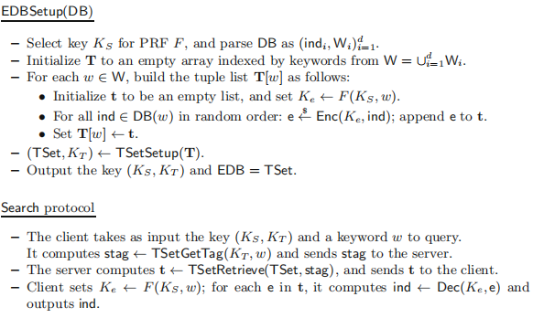













T-sets and single keyword search (SKS)
$$w_{1}$$
$K_{e_{1}}←F(K_{s},w_{1})$, $e_{11}\underset{←}{s}Enc\left(K_{e_{1}},{id}_{1}\right),e_{13}\underset{←}{s}Enc(K_{e_{1}},{id}_{3})$
$K_{e_{2}}←F(K_{s},w_{2})$, $e_{21}\underset{←}{s}Enc\left(K_{e_{2}},{id}_{1}\right),e_{22}\underset{←}{s}Enc(K_{e_{2}},{id}_{2})$ $e_{23}\underset{←}{s}Enc(K_{e_{2}},{id}_{3})$, $e_{24}\underset{←}{s}Enc(K_{e_{2}},{id}_{4})$
$K_{e_{3}}←F(K_{s},w_{3})$, $e_{32}\underset{←}{s}Enc(K_{e_{3}},{id}_{2})$, $e_{33}\underset{←}{s}Enc(K_{e_{3}},{id}_{3})$ $e_{34}\underset{←}{s}Enc(K_{e_{3}},{id}_{4})$
$$w_{2}$$
$$w_{3}$$
Search protocol
${stag}_{1}←TSetGetTag$($K_{T}$,$w_{1}$)
$K_{s}$,$K_{T}$和$w_{1}$
client
Bob
t$←TSetRetrieve(TSet,{stag}_{1})$
ind$←Dec(K_{e_{1}}$,e)
${id}_{1}$, ${id}_{3}$
$K_{e_{1}}←F(K_{s}$, $w_{1}$)
$$w_{1}$$
$${id}_{1}$$
$${id}_{3}$$
$$w_{2}$$
$${id}_{2}$$
$${id}_{4}$$
$${id}_{1}$$
$${id}_{3}$$
$${id}_{2}$$
$${id}_{4}$$
$$w_{3}$$
$${id}_{3}$$

Slide 6








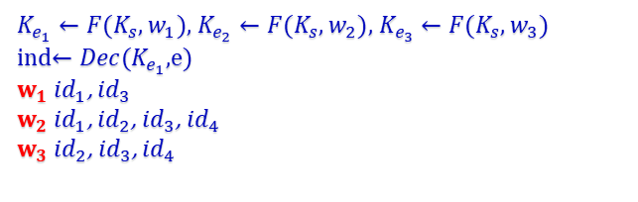


SSE Schemes For Conjunctive Keyword Search
Search protocol
${stag}_{1}←TSetGetTag$($K_{T}$,$w_{1}$)
$K_{e_{1}}←F(K_{s},w_{1})$, $K_{e_{2}}←F(K_{s},w_{2})$, $K_{e_{3}}←F(K_{s},w_{3})$
ind$←Dec(K_{e_{1}}$,e)
$w_{1}$ ${id}_{1}$, ${id}_{3}$
$w_{2}$ ${id}_{1}$, ${id}_{2}$, ${id}_{3}$, ${id}_{4}$
$w_{3}$ ${id}_{2}$, ${id}_{3}$, ${id}_{4}$
$K_{s}$,$K_{T}$和$w_{1}$
client
$$×$$
Bob
Bob
t$←TSetRetrieve(TSet,{stag}_{1})$
$${id}_{3}$$
$${id}_{1}$$
$${id}_{2}$$
$${id}_{3}$$
$${id}_{4}$$
检索陷门
$$f(k,w_{1}∧w_{2}∧w_{3})$$
$$w_{1}$$
$${id}_{1}$$
$${id}_{3}$$
$$w_{1}$$
$$w_{1}$$
$$w_{1}$$
$$w_{1}$$
$$w_{2}$$
$${id}_{2}$$
$${id}_{4}$$
$$w_{2}$$
$$w_{2}$$
$$w_{2}$$
$$w_{2}$$
$${id}_{1}$$
$${id}_{3}$$
$${id}_{2}$$
$${id}_{4}$$
$$w_{3}$$
$$w_{3}$$
$${id}_{3}$$
TSet
XSet

Slide 7





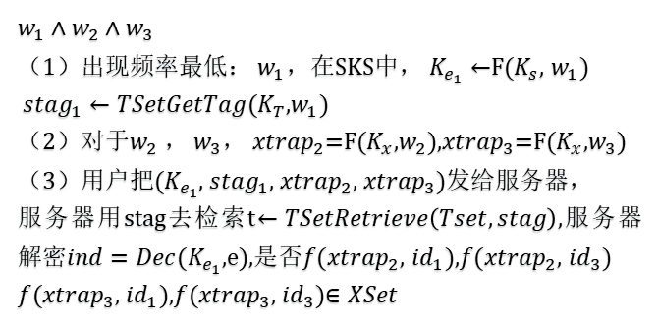

Basic Cross-Tags(BXT) Protocol
EDBSetup(DB)
Search protocol
-$w_{1}∈W$， $w_{2}∈W$， $w_{3}∈W$
$w_{1}∧$ $w_{2}$ $∧$ $w_{3}$
（1）出现频率最低： $w_{1}$，在SKS中， $K_{e_{1}}←$F($K_{s}$, $w_{1}$)
${stag}_{1}←TSetGetTag(K_{T}$,$w_{1}$)
（2）对于$w_{2}$ ， $w_{3}$， ${xtrap}_{2}$=F($K_{x}$,$w_{2}$),${xtrap}_{3}$=F($K_{x}$,$w_{3}$)
（3）用户把($K_{e_{1}}$, ${stag}_{1}$, ${xtrap}_{2}$, ${xtrap}_{3}$)发给服务器，
服务器用stag去检索t$←TSetRetrieve\left(Tset,stag\right),$服务器解密$ind=Dec(K_{e_{1}}$,e),是否$f({xtrap}_{2}$, ${id}_{1}$),$f({xtrap}_{2}$, ${id}_{3}$)
$f({xtrap}_{3}$, ${id}_{1}$),$f({xtrap}_{3}$, ${id}_{3}$)$∈XSet$
${xtrap}_{1}$=F($K_{x}$,$w_{1}$), ${xtrap}_{2}$=F($K_{x}$,$w_{2}$), ${xtrap}_{3}$=F($K_{x}$,$w_{3}$)
-
$ind∈DB(w_{1}$)
${xtag}_{11}$=$f({xtrap}_{1}$,${id}_{1}$)
${xtag}_{13}$=$f({xtrap}_{1}$,${id}_{3}$)
- $ind∈DB(w_{2}$)
${ xtag}_{21}$=$f({xtrap}_{2}$,${id}_{1}$)
${ xtag}_{22}$=$f({xtrap}_{2}$,${id}_{2}$)
${ xtag}_{23}$=$f({xtrap}_{2}$,${id}_{3}$)
${ xtag}_{24}$=$f({xtrap}_{2}$,${id}_{4}$)
- $ind∈DB(w_{3}$)
${ xtag}_{32}$=$f({xtrap}_{3}$,${id}_{2}$)
${ xtag}_{33}$=$f({xtrap}_{3}$,${id}_{3}$)
${ xtag}_{34}$=$f({xtrap}_{3}$,${id}_{4}$)
$$√$$
XSet
$$√$$
$${id}_{3}$$
$$√$$

Slide 8
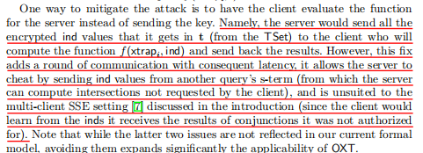




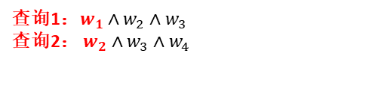

Choosing the S-Term/Oblivious Cross-Tags (OXT) Protocol
查询1：$w_{1}∧w_{2}∧w_{3}$
查询2： $w_{2}∧w_{3}∧w_{4}$
$${id}_{1}$$
$${id}_{2}$$
$${id}_{3}$$
$${id}_{4}$$
检索陷门
$$f(k,w_{1}∧w_{2}∧w_{3})$$
$$w_{1}$$
$${id}_{1}$$
$${id}_{3}$$
$$w_{1}$$
$$w_{1}$$
$$w_{1}$$
$$w_{1}$$
$$w_{2}$$
$${id}_{2}$$
$${id}_{4}$$
$$w_{2}$$
$$w_{2}$$
$$w_{2}$$
$$w_{2}$$
$${id}_{1}$$
$${id}_{3}$$
$${id}_{2}$$
$${id}_{4}$$
$$w_{3}$$
$$w_{3}$$
$${id}_{3}$$
TSet
XSet

Slide 9
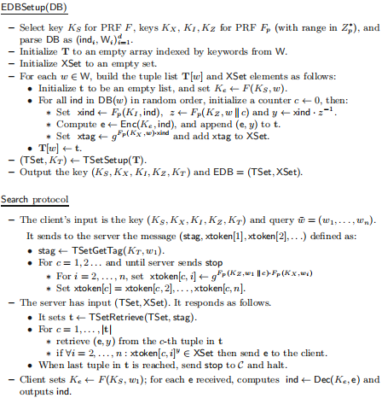


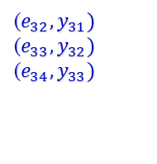
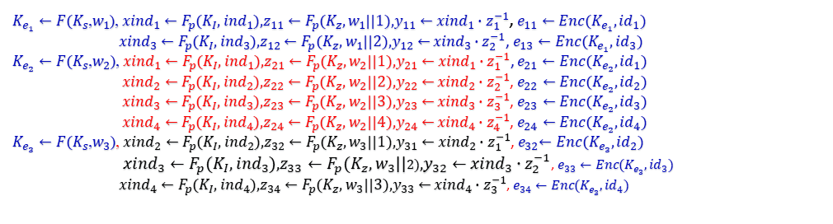

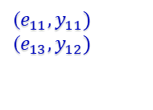

Oblivious Cross-Tags (OXT) Protocol
$K_{e_{1}}←F(K_{s}$,$w_{1}$), ${xind}_{1}←F_{p}$($K_{I}$, ${ind}_{1}$),$z_{11}←F_{p}$($K_{z}$, $w_{1}$||1),$y_{11}←$ ${xind}_{1}∙z_{1}^{−1}$, $e_{11}←Enc(K_{e_{1}},{id}_{1})$
${xind}_{3}←F_{p}$($K_{I}$, ${ind}_{3}$),$z_{12}←F_{p}$($K_{z}$, $w_{1}$||2),$y_{12}←$ ${xind}_{3}∙z_{2}^{−1}$, $e_{13}←Enc(K_{e_{1}},{id}_{3})$
$K_{e_{2}}←F(K_{s}$,$w_{2}$), ${xind}_{1}←F_{p}$($K_{I}$, ${ind}_{1}$),$z_{21}←F_{p}$($K_{z}$, $w_{2}$||1),$y_{21}←$ ${xind}_{1}∙z_{1}^{−1}$, $e_{21}←Enc(K_{e_{2}},{id}_{1})$
${xind}_{2}←F_{p}$($K_{I}$, ${ind}_{2}$),$z_{22}←F_{p}$($K_{z}$, $w_{2}$||2),$y_{22}←$ ${xind}_{2}∙z_{2}^{−1}$, $e_{22}←Enc(K_{e_{2}},{id}_{2})$
${xind}_{3}←F_{p}$($K_{I}$, ${ind}_{3}$),$z_{23}←F_{p}$($K_{z}$, $w_{2}$||3),$y_{23}←$ ${xind}_{3}∙z_{3}^{−1}$, $e_{23}←Enc(K_{e_{2}},{id}_{3})$
${xind}_{4}←F_{p}$($K_{I}$, ${ind}_{4}$),$z_{24}←F_{p}$($K_{z}$, $w_{2}$||4),$y_{24}←$ ${xind}_{4}∙z_{4}^{−1}$, $e_{24}←Enc(K_{e_{2}},{id}_{4})$
$K_{e_{3}}←F(K_{s}$,$w_{3}$), ${xind}_{2}←F_{p}$($K_{I}$, ${ind}_{2}$),$z_{32}←F_{p}$($K_{z}$, $w_{3}$||1),$y_{31}←$ ${xind}_{2}∙z_{1}^{−1}$,${ e}_{32}←Enc(K_{e_{3}},{id}_{2})$
${xind}_{3}←F_{p}$($K_{I}$, ${ind}_{3}$),$z_{33}←F_{p}$($K_{z}$, $w_{3}$||2),$y_{32}←$ ${xind}_{3}∙z_{2}^{−1}$, $e_{33}←Enc(K_{e_{3}},{id}_{3})$
${xind}_{4}←F_{p}$($K_{I}$, ${ind}_{4}$),$z_{34}←F_{p}$($K_{z}$, $w_{3}$||3),$y_{33}←$ ${xind}_{4}∙z_{3}^{−1}$, $e_{34}←Enc(K_{e_{3}},{id}_{4})$
$$K_{e_{1}}$$
$$K_{e_{2}}$$
$$K_{e_{3}}$$
($e_{11},y_{11})$
($e_{13},y_{12})$
($e_{21},y_{21})$
($e_{22},y_{22})$
($e_{23},y_{23})$
($e_{24},y_{24})$
($e_{32},y_{31})$
($e_{33},y_{32})$
($e_{34},y_{33})$

Slide 10

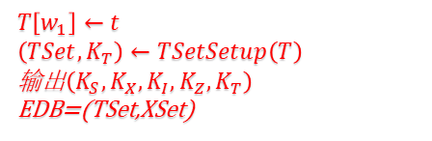

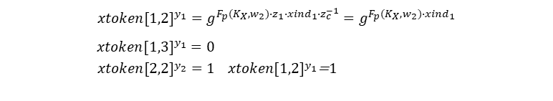
Oblivious Cross-Tags (OXT) Protocol
•
$$DB(w_{1})$$
$${xtag}_{11}←g^{F_{p}(K_{X},w_{1})∙{xind}_{1}}$$
$${xtag}_{13}←g^{F_{p}(K_{X},w_{1})∙{xind}_{3}}$$
$$DB(w_{2})$$
$${xtag}_{21}←g^{F_{p}(K_{X},w_{2})∙{xind}_{1}}$$
$${xtag}_{22}←g^{F_{p}(K_{X},w_{2})∙{xind}_{2}}$$
$${xtag}_{23}←g^{F_{p}(K_{X},w_{2})∙{xind}_{3}}$$
$${xtag}_{24}←g^{F_{p}(K_{X},w_{2})∙{xind}_{4}}$$
$$DB(w_{3})$$
$${xtag}_{32}←g^{F_{p}(K_{X},w_{3})∙{xind}_{2}}$$
$${xtag}_{33}←g^{F_{p}(K_{X},w_{3})∙{xind}_{3}}$$
$${xtag}_{34}←g^{F_{p}(K_{X},w_{3})∙{xind}_{4}}$$
Search Protocol
（1）用户输入$\left(K_{S},K_{X},K_{I},K_{Z},K_{T}\right)$以及查询
$w_{1}∧$ $w_{2}$ $∧$ $w_{3}$
用户向服务器发送${stag}_{1},xtoken\left[1\right],xtoken\left[2\right]$
定义：
$${stag}_{1}←TSetGetTag(K_{T},w_{1})$$
c=1,2
$$xtoken[1,2]←g^{F_{p}(K_{Z},w_{1}||1)∙F_{p}(K_{X},w_{2})}$$
$$xtoken[1,3]←g^{F_{p}(K_{Z},w_{1}||1)∙F_{p}(K_{X},w_{3})}$$
$$xtoken[2,2]←g^{F_{p}(K_{Z},w_{1}||2)∙F_{p}(K_{X},w_{2})}$$
$$xtoken[2,3]←g^{F_{p}(K_{Z},w_{1}||2)∙F_{p}(K_{X},w_{3})}$$
$$xtoken\left[1\right]=xtoken\left[1,2\right],xtoken[1,3]$$
$$xtoken\left[2\right]=xtoken\left[2,2\right],xtoken[2,3]$$
XSet
•
$$T\left[w_{1}\right]←t$$
$$\left(TSet,K_{T}\right)←TSetSetup\left(T\right)$$
输出$\left(K_{S},K_{X},K_{I},K_{Z},K_{T}\right)$
EDB=(TSet,XSet)
$${xtoken[1,2]}^{y_{1}}=g^{F_{p}(K_{X},w_{2})∙z_{1}∙{xind}_{1}∙z_{c}^{−1}}=g^{F_{p}(K_{X},w_{2})∙{xind}_{1}}$$
${xtoken[1,3]}^{y_{1}}=0$
${xtoken[2,2]}^{y_{2}}=1$ ${xtoken[1,2]}^{y_{1}}$=1
=1

Slide 11









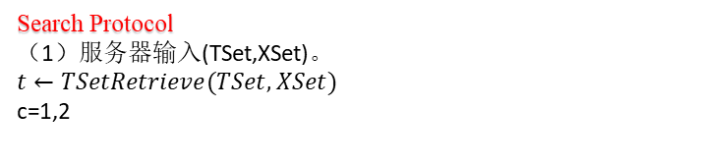




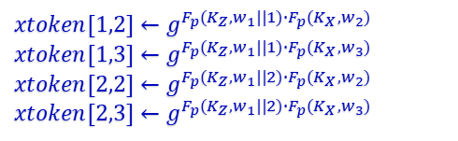
Oblivious Cross-Tags (OXT) Protocol
Search Protocol
（1）服务器输入(TSet,XSet)。
$$t←TSetRetrieve(TSet,XSet)$$
c=1,2
$$K_{e_{1}}$$
$$K_{e_{2}}$$
$$K_{e_{3}}$$
$${id}_{1}$$
$${id}_{2}$$
$${id}_{3}$$
$${id}_{4}$$
$$w_{1}$$
$${id}_{1}$$
$${id}_{3}$$
$$w_{1}$$
$$w_{1}$$
$$w_{1}$$
$$w_{1}$$
$$t_{1}$$
($e_{11},y_{11})$
($e_{13},y_{12})$
($e_{21},y_{21})$
($e_{22},y_{22})$
($e_{23},y_{23})$
($e_{24},y_{24})$
($e_{32},y_{31})$
($e_{33},y_{32})$
($e_{34},y_{33})$
$$w_{2}$$
$${id}_{2}$$
$${id}_{4}$$
$${id}_{1}$$
$${id}_{3}$$
$$w_{2}$$
$$w_{2}$$
$$w_{2}$$
$$w_{2}$$
$$t_{2}$$
$${id}_{2}$$
$${id}_{4}$$
$$w_{3}$$
$${id}_{3}$$
$$w_{3}$$
$$√$$
TSet
XSet
$$xtoken[1,2]←g^{F_{p}(K_{Z},w_{1}||1)∙F_{p}(K_{X},w_{2})}$$
$$xtoken[1,3]←g^{F_{p}(K_{Z},w_{1}||1)∙F_{p}(K_{X},w_{3})}$$
$$xtoken[2,2]←g^{F_{p}(K_{Z},w_{1}||2)∙F_{p}(K_{X},w_{2})}$$
$$xtoken[2,3]←g^{F_{p}(K_{Z},w_{1}||2)∙F_{p}(K_{X},w_{3})}$$
$$×$$
结果为 ${id}_{3}$
$$√$$
$$√$$

Slide 12



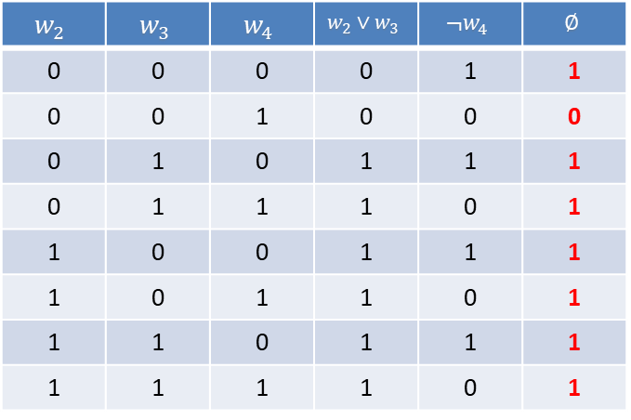






Processing Boolean Queries with OXT
$w_{1}∧∅\left(w_{2},w_{3},w_{4}\right)$ $w_{1}∧(w_{2}∨w_{3}∨¬w_{4})$ $\hat{∅}(v_{2},v_{3},v_{4})$
$$w_{2}$$ | $$w_{3}$$ | $$w_{4}$$ | $$w_{2}∨w_{3}$$ | $$¬w_{4}$$ | $$∅$$
0 | 0 | 0 | 0 | 1 | 1
0 | 0 | 1 | 0 | 0 | 0
0 | 1 | 0 | 1 | 1 | 1
0 | 1 | 1 | 1 | 0 | 1
1 | 0 | 0 | 1 | 1 | 1
1 | 0 | 1 | 1 | 0 | 1
1 | 1 | 0 | 1 | 1 | 1
1 | 1 | 1 | 1 | 0 | 1
$${id}_{1}$$
$${id}_{2}$$
$${id}_{3}$$
$${id}_{4}$$
$$w_{1}$$
$${id}_{1}$$
$${id}_{3}$$
$$w_{1}$$
$$w_{2}$$
$$w_{1}$$
$$w_{2}$$
$$w_{2}$$
$${id}_{2}$$
$${id}_{4}$$
$$w_{2}$$
$$w_{3}$$
$$w_{2}$$
$$w_{3}$$
$${id}_{1}$$
$${id}_{3}$$
$${id}_{2}$$
$${id}_{4}$$
$$w_{4}$$
$$w_{3}$$
$$w_{4}$$
$$w_{3}$$
$${id}_{3}$$
$$w_{4}$$
$${id}_{2}$$
$$w_{4}$$
$${id}_{3}$$
$${id}_{4}$$

Slide 13
THANKS!

